Slide 1
My KOKO Updates & Fixes
Share credit fix
Fix updated referral system
Copy update on make money screen
Fix commission display bug
Copy on onboarding screen
Increase app session of app
PIN-verify share credit
Display enter referrer code
Display accurate bonus amount

Slide 2

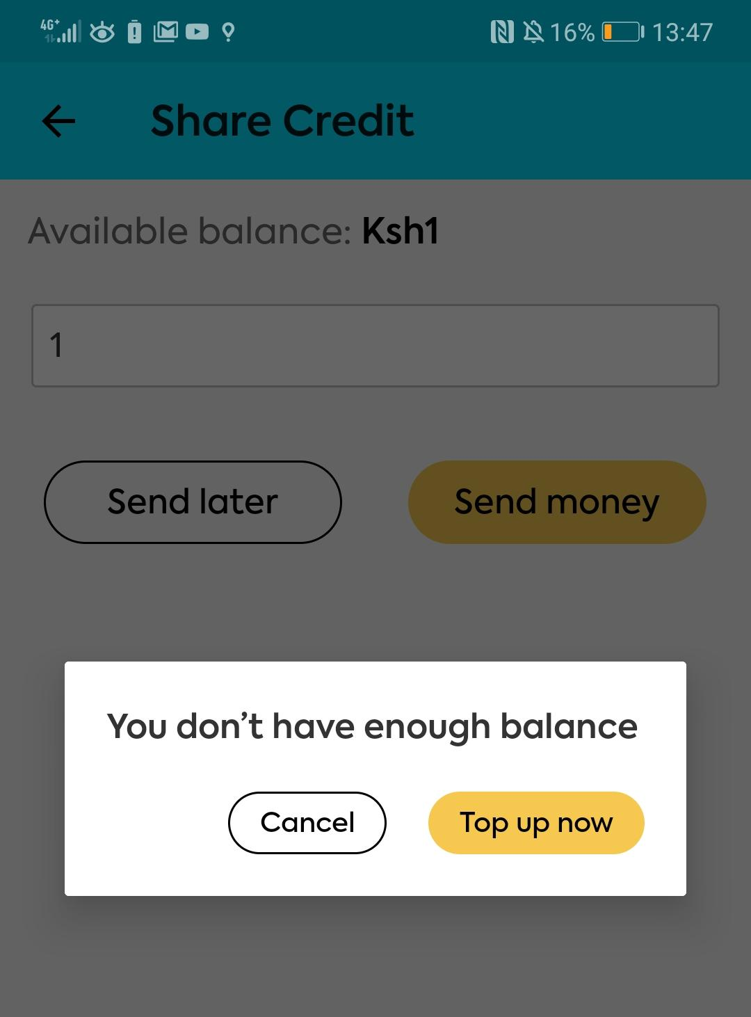
Fix: Can’t share all my credit
R39
Approved
Description:
The app won’t allow the user to share their full balance but instead forces them to keep Ksh in their balance and tells them they don’t have enough balance.
Expected outcome:
Want to stop creating a problem where customers have orders and balances if they are not actively engaged in KOKO. Skewing our sales reporting. Also doesn’t allow customer to use all their credit.

Slide 3
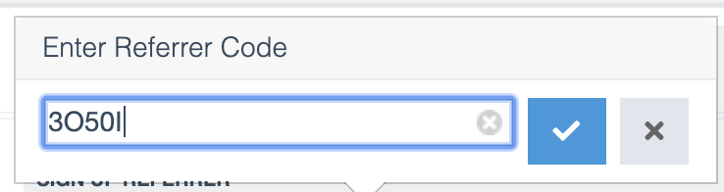
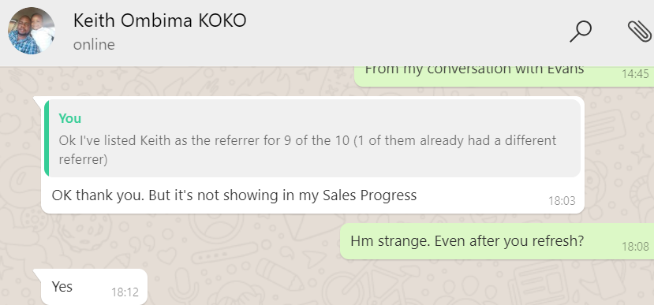
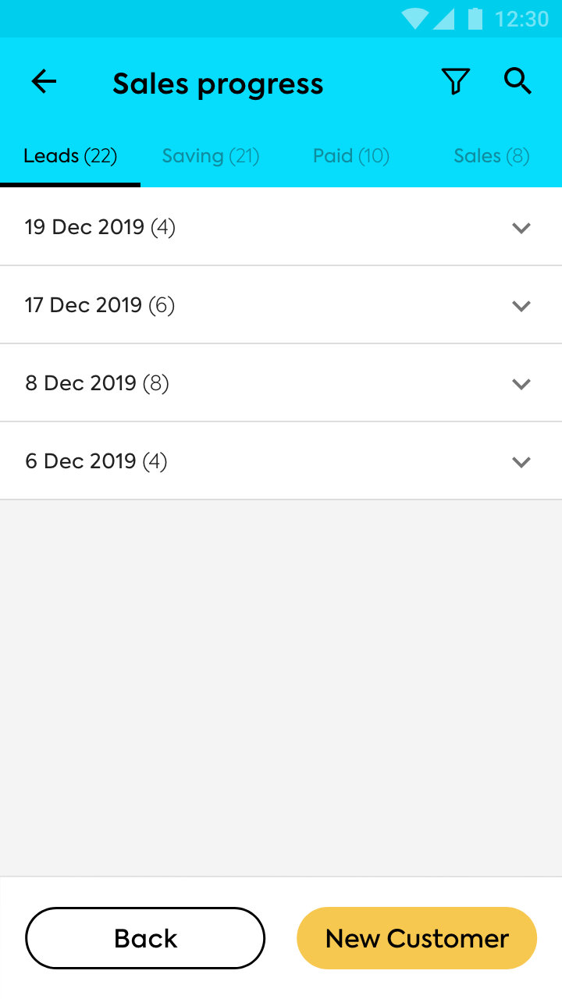
Fix: Updated referrals not appearing on Sales Lists
R39
Approved
Description:
If a CSR is assigned new customers via KOKO Admin, he/she is not able to see these new customers on the app
Expected outcome:
A CSR should see all the customers that are assigned to them, even when that is updated on KOKO Core.
Note
The order referrer is checked only when the order is fullfiled.
This needs to be checked in real-time (when changed) and displayed on the correct list of the updated referrer.

Slide 4
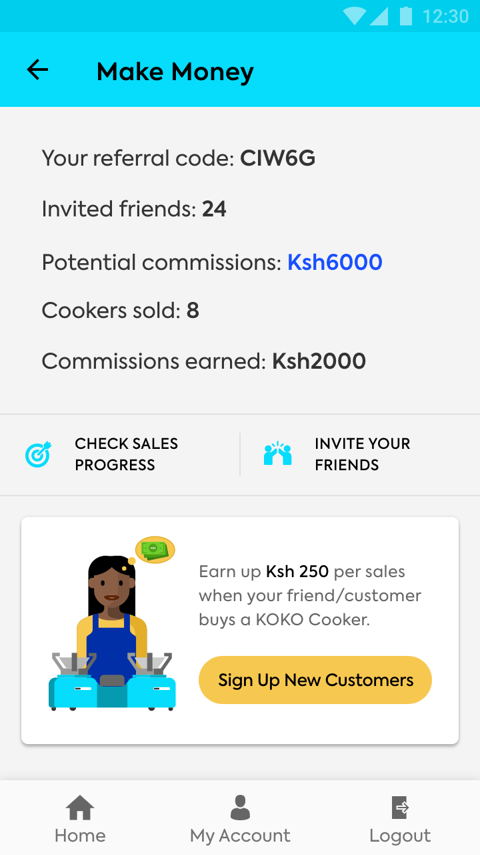
Fix: Copy on Make Money screen
R39
Approved
Current Outcome:
Make Money screen states “invited friends” to indicate customers signed-up. “Invite friends” is actually a different action than “Sign up new customer.”
Expected outcome:
Modify the text as follows:
“Invited friends” changed to “Customers signed-up”

Slide 5
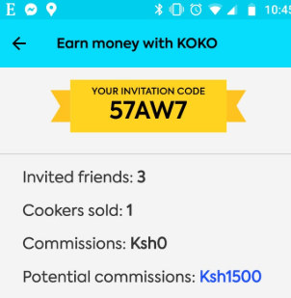
Bug: Commissions earned inaccurate
Fixed in Previous Release
Current Outcome:
Commissions amount is not being displayed correctly on sales progress screen
Expected outcome: Commissions earned should reflect number of cookers sold (commission amount * total cookers sold)
Notes/extra details eg. screenshots
Sold 1 cooker and earned a commission for it, but the app routinely shows that commission earned =0

Slide 6
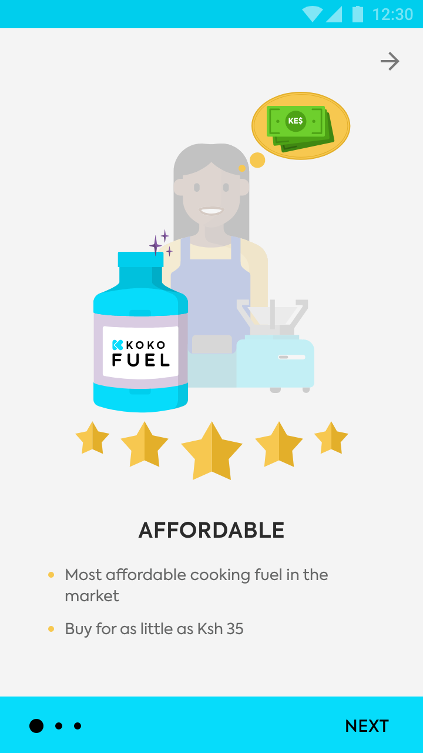
Fix: App still states Ksh 35 minimum
R40
Approved
Description:
Onboarding screen still states that you can buy as low as KSH 35, rather than KSH 30
Expected outcome: Generally, any text in the app should align with the latest from the business. It would be good to map out the latest copy on the myKOKO app so that we ensure it is up-to-date with the most critical information.
Fix description:
The app should state that fuel can be bought for a little as Ksh.30

Slide 7
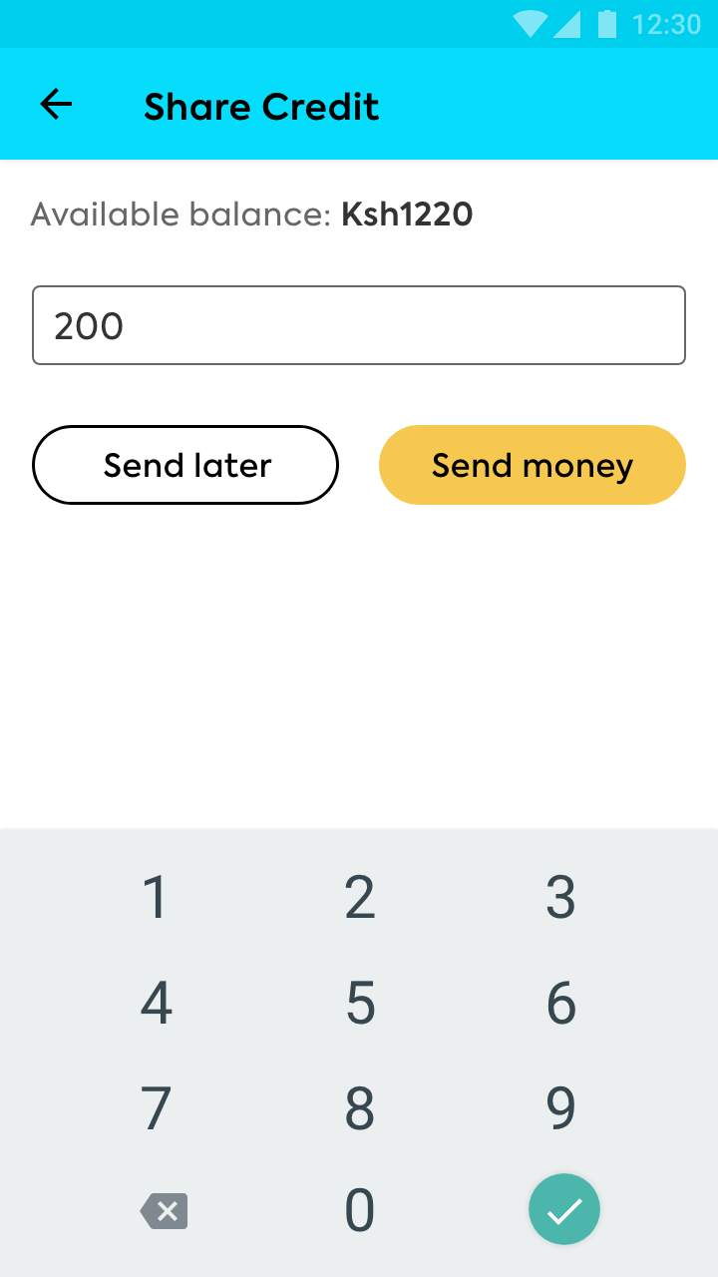
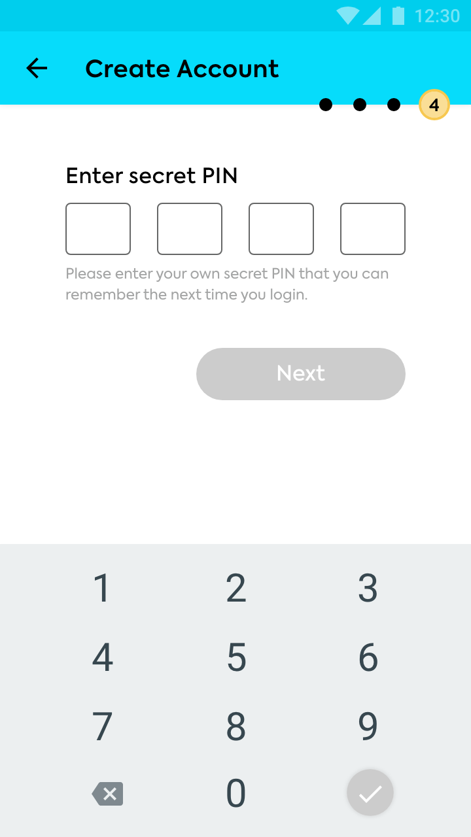
Fix: App session is too short
R39
Approved
The app currently logs users out after 35 seconds.
A planned fix (for early March) is to lengthen the app session to 35 seconds, but this may still be too short. What exactly are we protecting by keeping the session as short as it is? Are there other ways to solve for that?
Suggested Fix: Allow the user to protect key features of the app and stay logged in for longer.
Add password protection to the ‘Share Credit’ feature. Steps:
User clicks on ‘Share Credit’
They input the number and amount to send.
They tap ‘Send Money’
They type their secret PIN
Money/Credit is sent successfully
Keep the user logged in to the app for 30 minutes (in background).
Notes/extra details eg. screenshots

Slide 8
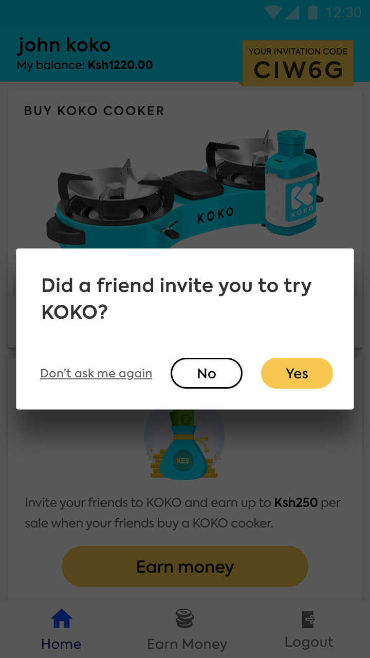
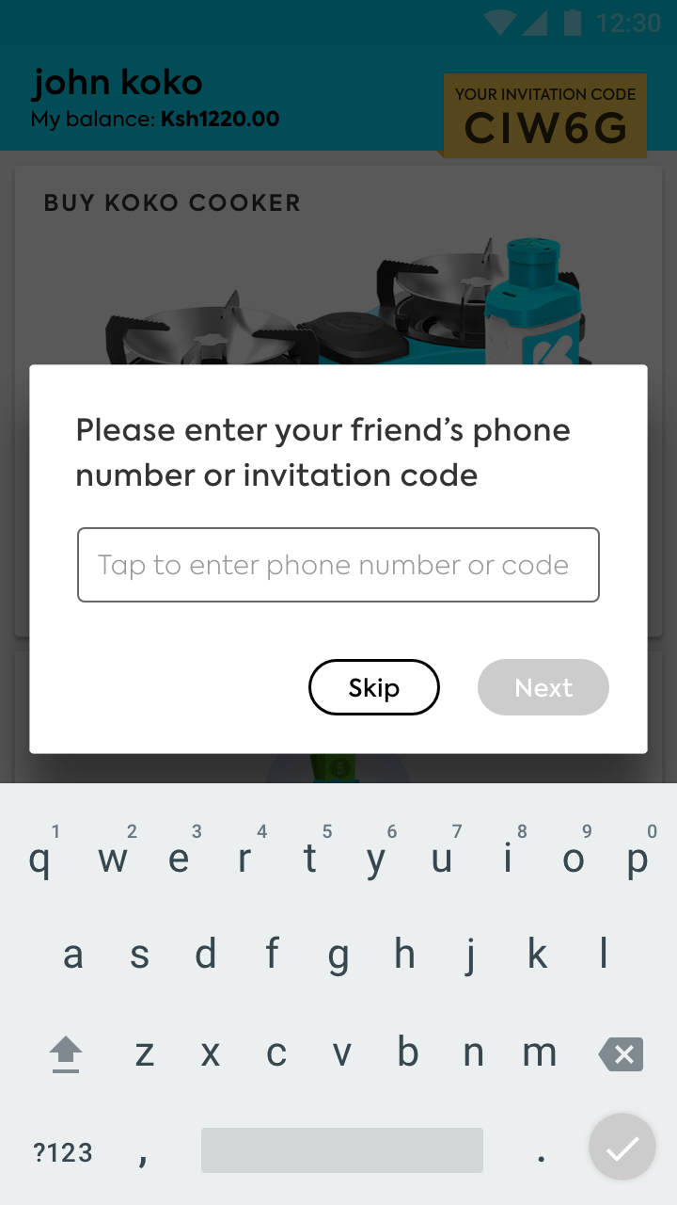
Display Referrer Code
R40
Updated Post-Demo
Context:
When users log into MyKOKO for the first time, they are requested to share a referral code of the person that introduced them to KOKO.
Fix Description:
Display this request only if:
Customer does not own a cooker
Customer does not have a referral code logged against them on KOKO Core

Slide 9
Display the accurate bonus amount per customer type
R40
Introduced Post-Demo
Context:
On the Make Money & Home Screen, the bonus amount that the customer can earn is displayed on the card at the bottom of the page.
Different customer types earn different bonus amounts. The amount displayed now is a static Ksh.250, even though not every user/customer earns Ksh.250 for making a sale.
Fix Description:
Display the correct bonus amount per customer type:
Customer - Ksh.250
CSR - Ksh. 550
Employee - Ksh.500
Different customer types earn different bonus amounts.
This amount should reflect the correct bonus amount per customer type.

Slide 10
Release Plan for Fixes
R39:
Ability to share all (100%) credit from one user’s account to another
Ability to update customer information on the sales progess list in real time (update a referrer)
Ability to stay logged in for 30 minutes (background inactivity)
Ability to share credit through PIN-verification (security protocol)
Updated copy on invited customers on make money screen
R40:
Request to share referral code within the app for non-cooker owner customers and customers without a referrer on KOKO Core
Display bonus amount on make money screen to reflect the bonus tier of the customer type ie. CSRs - Ksh.550, customers - Ksh. 250; Employees - Ksh.500.
Copy on onboarding screen to reflect minimum of Ksh.30

Slide 11
Demo Feedback
17th June
[R40] Bring back referral code request if the customer does not own a cooker and if the customer does not have a referrer on KOKO Core
[R40] Display the potential bonus amount on make money screen to match the actual tier of the customer eg. customers can earn Ksh.250; CSRs can earn Ksh.550; employees can earn Ksh.500

Slide 12
For more information, contact:
Nyawira Njoroge
n.njoroge@kokonetworks.com

Slide 13
Expected Steps
Clarify open questions and potential user journeys
Discuss priority of different scope elements
Prepare final designs
Confirm sign off
Plan resourcing with Engineering Team
Walkthrough engineering team
Finalize the Release Plan with engineering

Slide 14
Project Scope Updates [scoping stage]
30th April
Removed decoupling sign up and order referrer fix from the scope
18th May
Removed updates to the sales progress list & filter
Removed commissions tracker
Removed edits to customer detail screen
22nd May
Add remove referrer code from My KOKO

